Slide 1
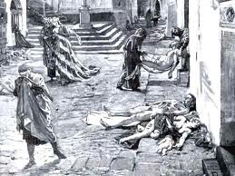
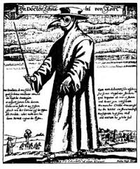
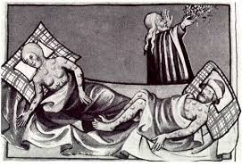
Notes:
What is happening in these pictures?
What do you think todays lesson is all about?

Slide 2
The black plague
LO: To understand what the black plague was and to understand what happened in the black plague.

Slide 3
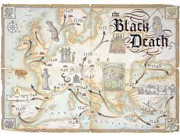
What do you think the black plague is?
Talk to your partner and tell them what you think the black plague is.

Slide 4

Black Plague Quiz
With the class, you are going to do a quiz about the black plague. From this quiz you will get lots of information from it, so pay attention!!! Also I will be asking you questions about the black death so stay focused!!!!
Notes:
Click on the picture for the quiz

Slide 5
Questions
Why do people whip themselves?
Why do people hold freshly plucked chickens?
Why was the town loud and noisy?
Why did people kill cats and dogs?
Why do doctors cut buboes up?

Slide 6
Task
Write a paragraph about what the black plague was all about and also write about what had happened in the black plague...

Slide 7
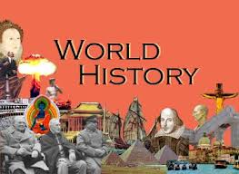
Homework
Create a poster warning people about the dangers of the black plague.
This is due for next week.
Notes:
Click on the picture for an example of a poster

